Slide 1
Description of Systems
M. J. Roberts - All Rights Reserved. Edited by Dr. Robert Akl
‹#›

Slide 2
Systems
Broadly speaking, a system is anything that responds when stimulated or excited
The systems most commonly analyzed by engineers are artificial systems designed and built by humans
Engineering system analysis is the application of mathematical methods to the design and analysis of systems
M. J. Roberts - All Rights Reserved. Edited by Dr. Robert Akl
‹#›

Slide 3
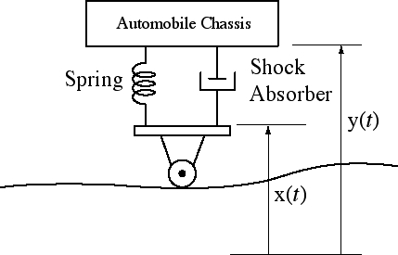
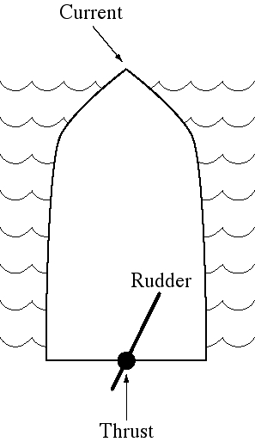
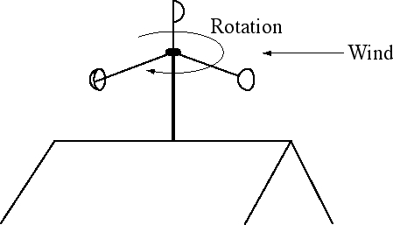
System Examples
M. J. Roberts - All Rights Reserved. Edited by Dr. Robert Akl
‹#›

Slide 4
Feedback Systems
In a feedback system the response of the system is “fed back”
and combined with the excitation is such a way as to optimize
the response in some desired sense. Examples of feedback
systems are
Temperature control in a house using a thermostat
Water level control in the tank of a flush toilet.
Pouring a glass of lemonade to the top of the glass without
overflowing.
A refrigerator ice maker which keeps the bin full of ice
but does not make extra ice.
Driving a car.
M. J. Roberts - All Rights Reserved. Edited by Dr. Robert Akl
‹#›

Slide 5

Systems
Systems have inputs and outputs
Systems accept excitations or input signals at their inputs and produce responses or output signals at their outputs
Systems are often usefully represented by block diagrams
A single-input, single-output system block diagram
M. J. Roberts - All Rights Reserved. Edited by Dr. Robert Akl
‹#›

Slide 6
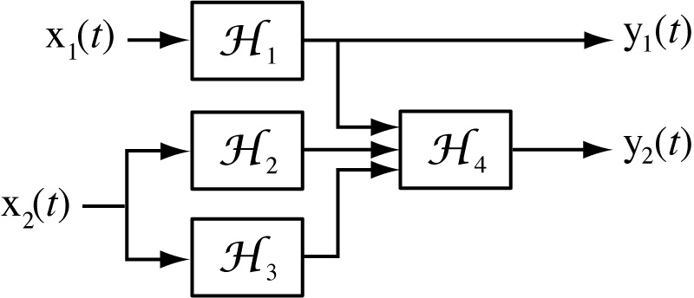
A Multiple-Input, Multiple-Output System Block Diagram
M. J. Roberts - All Rights Reserved. Edited by Dr. Robert Akl
‹#›

Slide 7
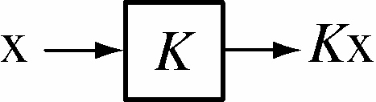
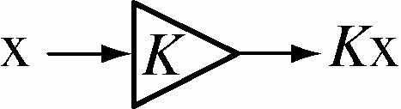
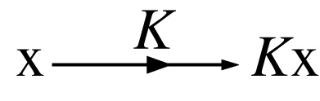
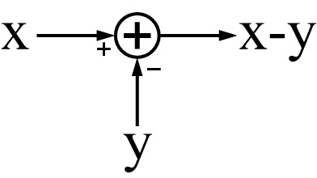
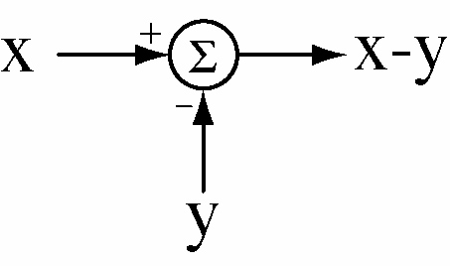
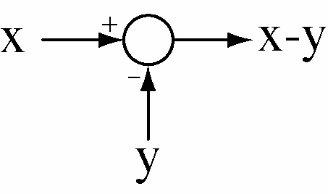
Block Diagram Symbols
Three common block diagram symbols for an amplifier (we will
use the last one).
Three common block diagram symbols for a summing junction
(we will use the first one).
M. J. Roberts - All Rights Reserved. Edited by Dr. Robert Akl
‹#›

Slide 8
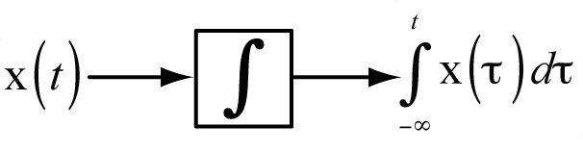
Block Diagram Symbols
Block diagram symbol for an integrator
M. J. Roberts - All Rights Reserved. Edited by Dr. Robert Akl
‹#›

Slide 9
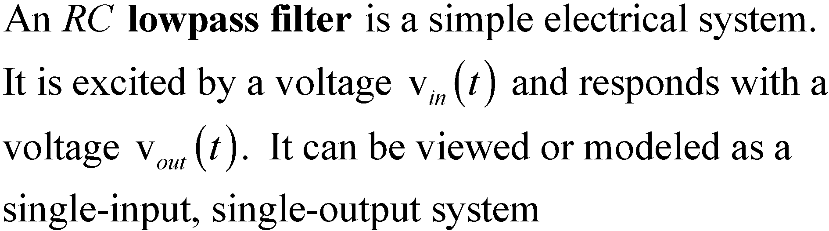
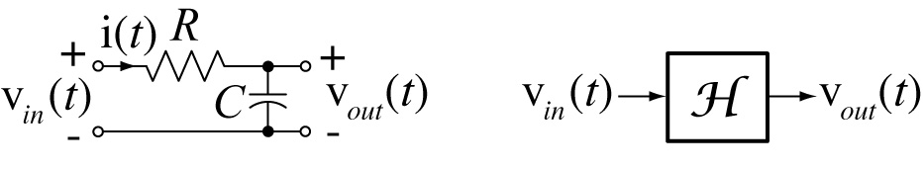
An Electrical Circuit Viewed as a System
M. J. Roberts - All Rights Reserved. Edited by Dr. Robert Akl
‹#›

Slide 10
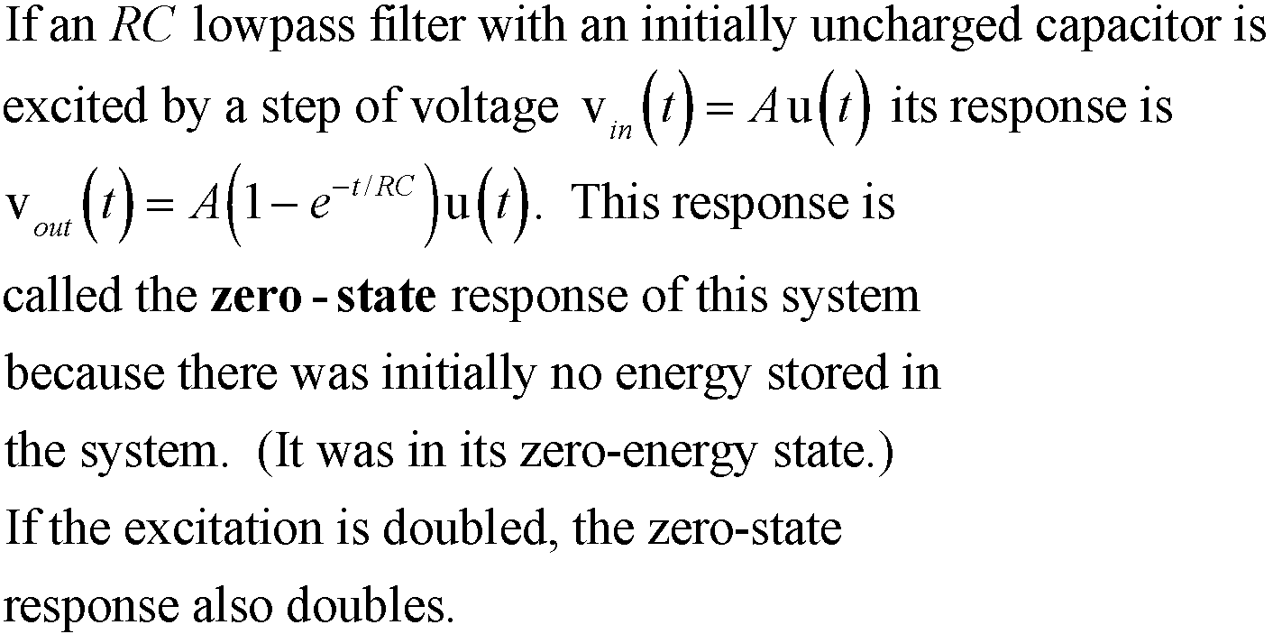
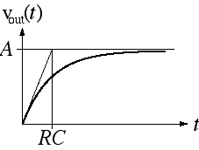
Zero-State Response of an RC Lowpass Filter to a Step Excitation
M. J. Roberts - All Rights Reserved. Edited by Dr. Robert Akl
‹#›

Slide 11
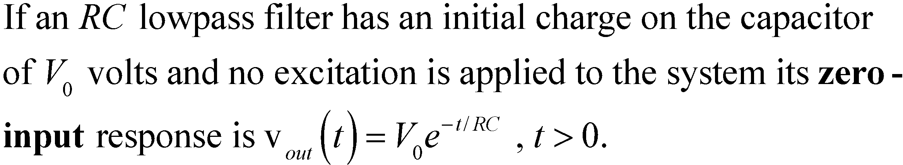
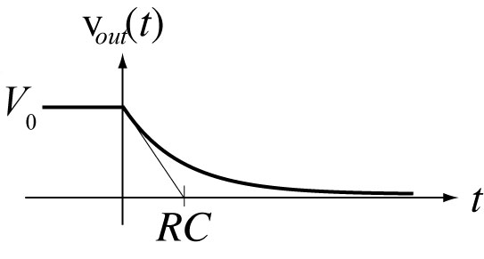
Zero-Input Response of an RC Lowpass Filter
M. J. Roberts - All Rights Reserved. Edited by Dr. Robert Akl
‹#›

Slide 12
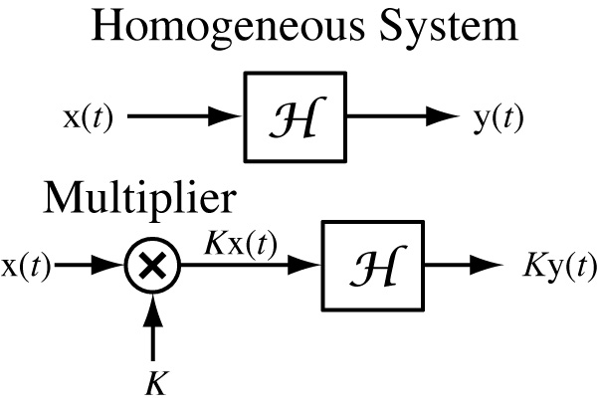
Homogeneity
In a homogeneous system, multiplying the excitation by any constant (including complex constants), multiplies the zero-state response by the same constant.
M. J. Roberts - All Rights Reserved. Edited by Dr. Robert Akl
‹#›

Slide 13
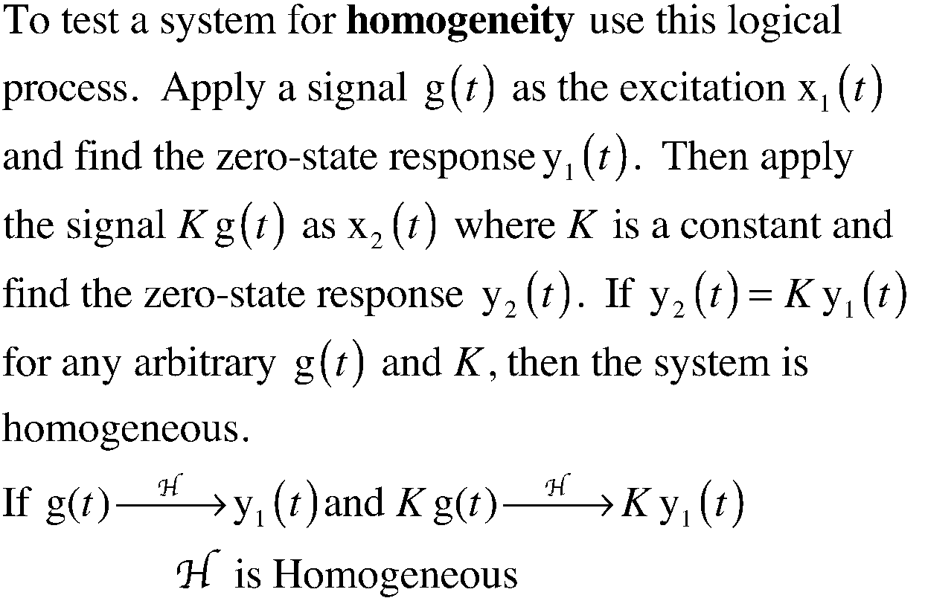
Homogeneity
M. J. Roberts - All Rights Reserved. Edited by Dr. Robert Akl
‹#›

Slide 14
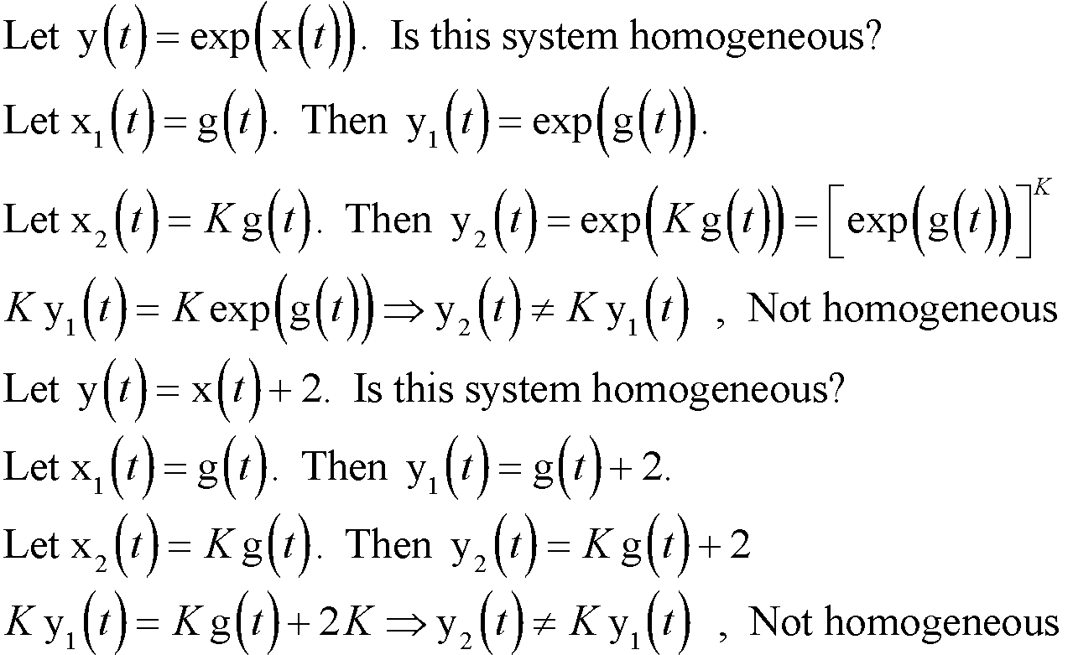
Homogeneity
M. J. Roberts - All Rights Reserved. Edited by Dr. Robert Akl
‹#›

Slide 15
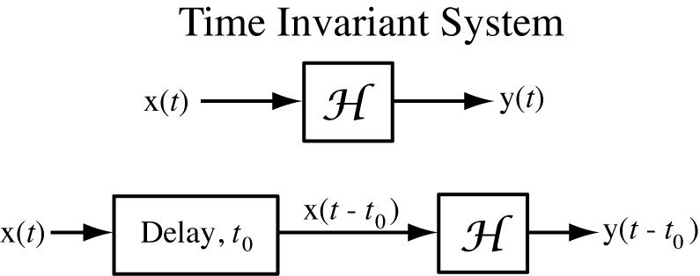
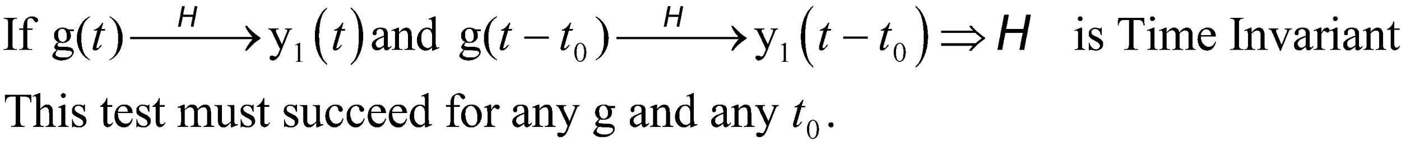
Time Invariance
If an excitation causes a zero-state response and delaying the excitation simply delays the zero-state response by the same amount of time, regardless of the amount of delay, the system is time invariant.
M. J. Roberts - All Rights Reserved. Edited by Dr. Robert Akl
‹#›

Slide 16
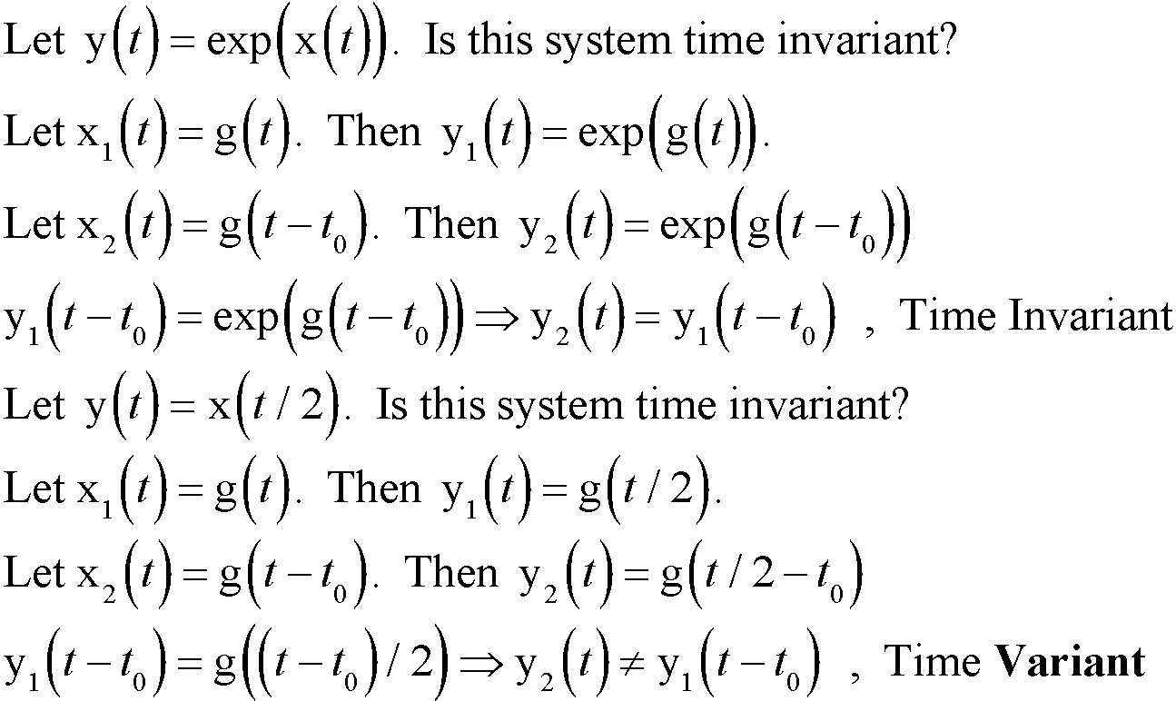
Time Invariance
M. J. Roberts - All Rights Reserved. Edited by Dr. Robert Akl
‹#›

Slide 17
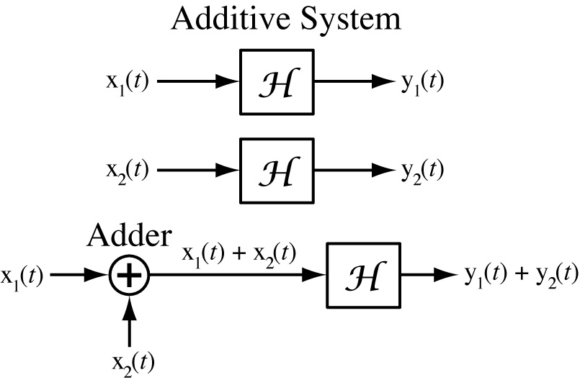
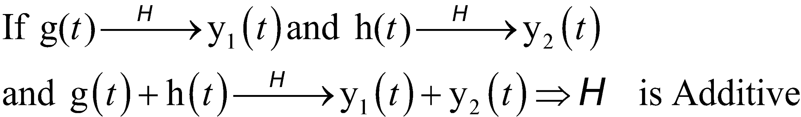
Additivity
If one excitation causes a zero-state response and another excitation causes another zero-state response and if, for any arbitrary excitations, the sum of the two excitations causes a zero-state response that is the sum of the
two zero-state responses, the
system is said to be additive.
M. J. Roberts - All Rights Reserved. Edited by Dr. Robert Akl
‹#›

Slide 18
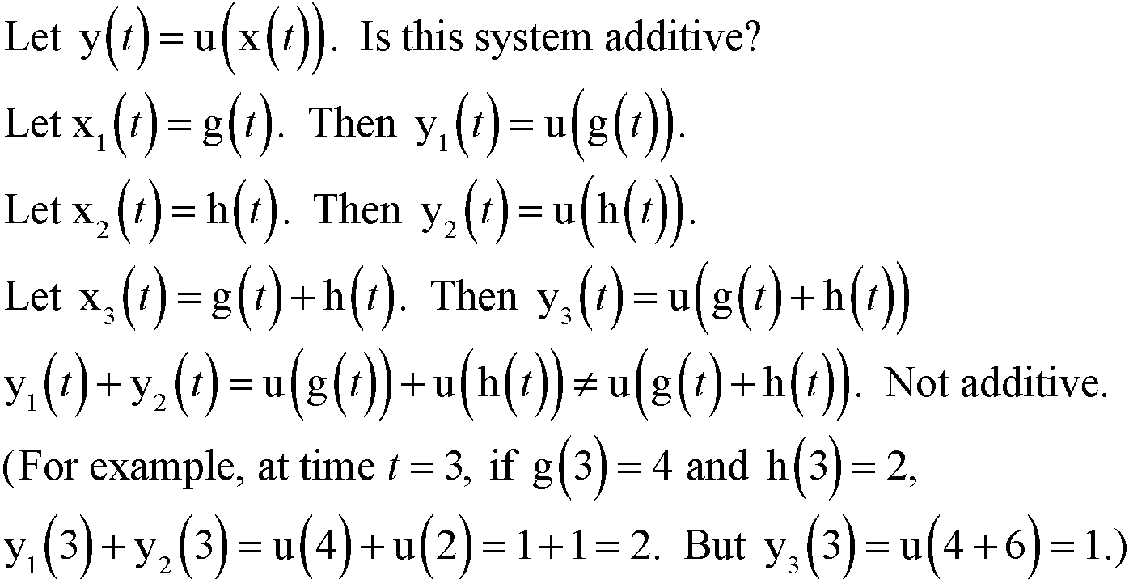
Additivity
M. J. Roberts - All Rights Reserved. Edited by Dr. Robert Akl
‹#›

Slide 19
Linearity and LTI Systems
If a system is both homogeneous and additive it is linear.
If a system is both linear and time-invariant it is called an LTI system
Some systems which are non-linear can be accurately approximated for analytical purposes by a linear system for small excitations
M. J. Roberts - All Rights Reserved. Edited by Dr. Robert Akl
‹#›

Slide 20
Stability
Any system for which the response is bounded for any arbitrary bounded excitation, is called a bounded-input-bounded-output (BIBO) stable system
A continuous-time LTI system described by a differential equation is stable if the eigenvalues of the solution of the equation all have negative real parts
M. J. Roberts - All Rights Reserved. Edited by Dr. Robert Akl
‹#›

Slide 21
Causality
Any system for which the zero-state response occurs only during or after the time in which the excitation is applied is called a causal system.
Strictly speaking, all real physical systems are causal
M. J. Roberts - All Rights Reserved. Edited by Dr. Robert Akl
‹#›

Slide 22
Memory
If a system’s zero-state response at any arbitrary time depends only on the excitation at that same time and not on the excitation or response at any other time it is called a static system and is said to have no memory. All static systems are causal.
A system whose zero-state response at some arbitrary time depends on anything other than
the excitation at that same time is called a dynamic system and is said to have memory
Any system containing an integrator has memory
M. J. Roberts - All Rights Reserved. Edited by Dr. Robert Akl
‹#›

Slide 23
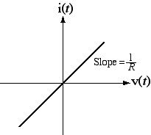
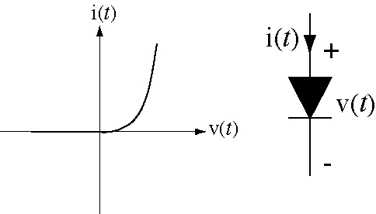
Static Non-Linearity
Many real systems are non-linear because the relationship between excitation amplitude and response amplitude is non-linear
V-I Diagram for a
Linear Resistor
V-I Diagram for a Diode
M. J. Roberts - All Rights Reserved. Edited by Dr. Robert Akl
‹#›

Slide 24
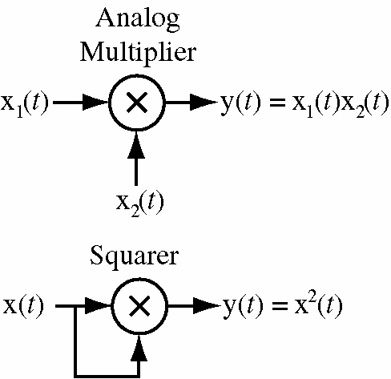
Static Non-Linearity
For an analog multiplier, if the two excitations are the same single excitation signal, the response signal is the square of that single excitation signal and doubling the excitation would cause the response to increase by a factor of 4
Such a system is not homogeneous and therefore not linear
M. J. Roberts - All Rights Reserved. Edited by Dr. Robert Akl
‹#›

Slide 25
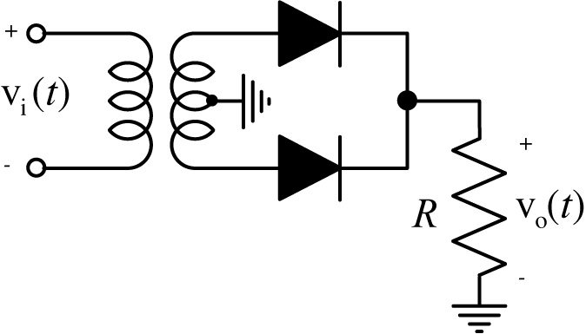
Invertibility
A system is said to be invertible if unique excitations produce unique zero-state responses. In other words, if a system is invertible, knowledge of the zero-state response is sufficient to determine the excitation
This full-wave rectifier is
a non-invertible system
M. J. Roberts - All Rights Reserved. Edited by Dr. Robert Akl
‹#›

Slide 26
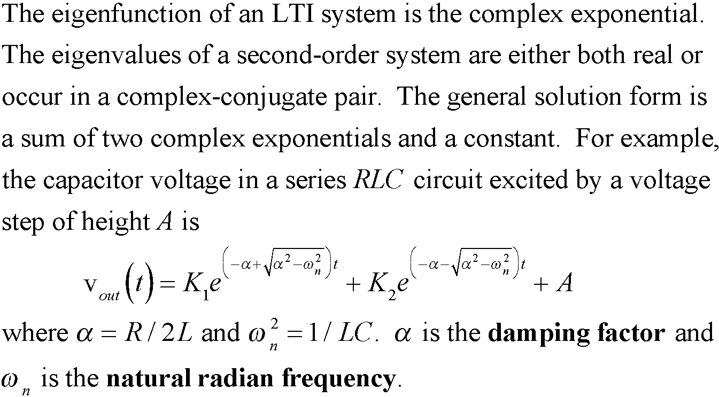
Dynamics of Second-Order Systems
M. J. Roberts - All Rights Reserved. Edited by Dr. Robert Akl
‹#›

Slide 27
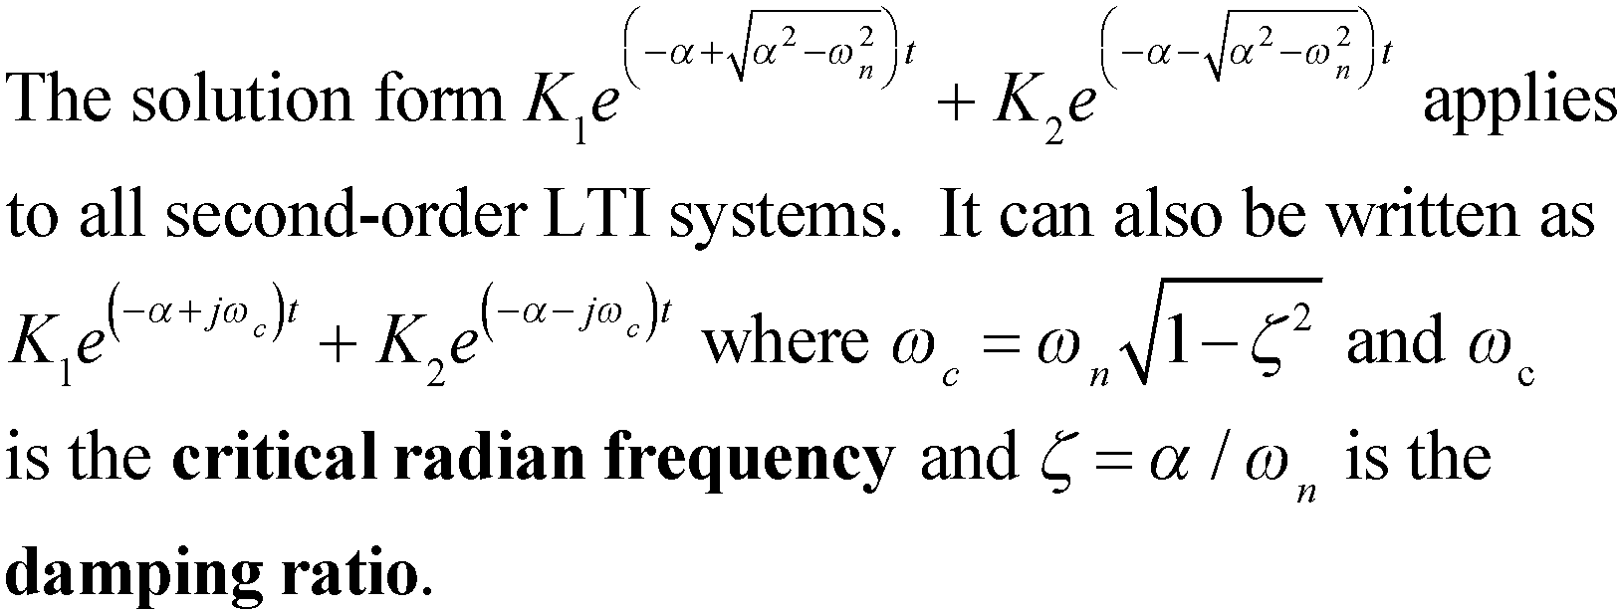
Dynamics of Second-Order Systems
M. J. Roberts - All Rights Reserved. Edited by Dr. Robert Akl
‹#›

Slide 28
Discrete-Time Systems
With the increase in speed and decrease in cost of digital system components, discrete-time systems have experienced, and are still experiencing, rapid growth in modern engineering system design
Discrete-time systems are usually described by difference equations
M. J. Roberts - All Rights Reserved. Edited by Dr. Robert Akl
‹#›

Slide 29
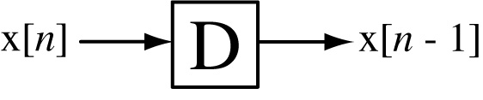
Block Diagram Symbols
The block diagram symbols for a summing junction and an
amplifier are the same for discrete-time systems as they are
for continuous-time systems.
Block diagram symbol for a delay
M. J. Roberts - All Rights Reserved. Edited by Dr. Robert Akl
‹#›

Slide 30
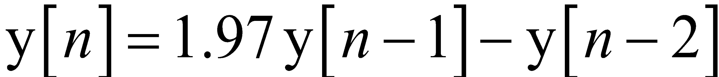
Discrete-Time Systems
In a discrete-time system events occur at points in time but not
between those points. The most important example is a digital
computer. Significant events occur at the end of each clock
cycle and nothing of significance (to the computer user) happens
between those points in time.
Discrete-time systems can be described by difference (not
differential) equations. Let a discrete-time system generate an
excitation signal y[n] where n is the number of discrete-time
intervals that have elapsed since some beginning time n = 0.
Then, for example a simple discrete-time system might be
described by
M. J. Roberts - All Rights Reserved. Edited by Dr. Robert Akl
‹#›

Slide 31
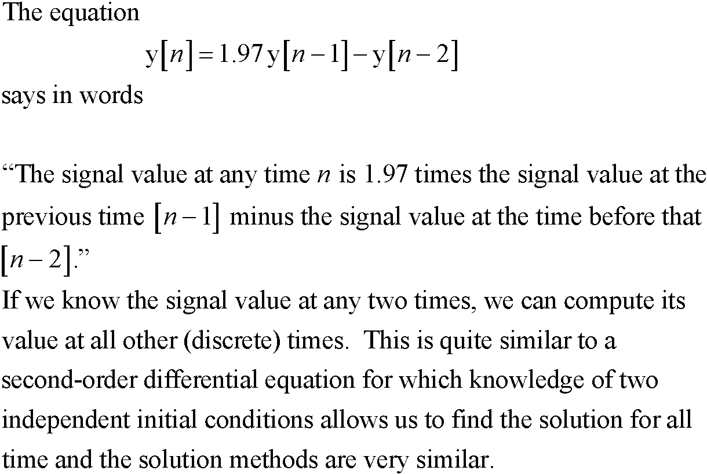
Discrete-Time Systems
M. J. Roberts - All Rights Reserved. Edited by Dr. Robert Akl
‹#›

Slide 32
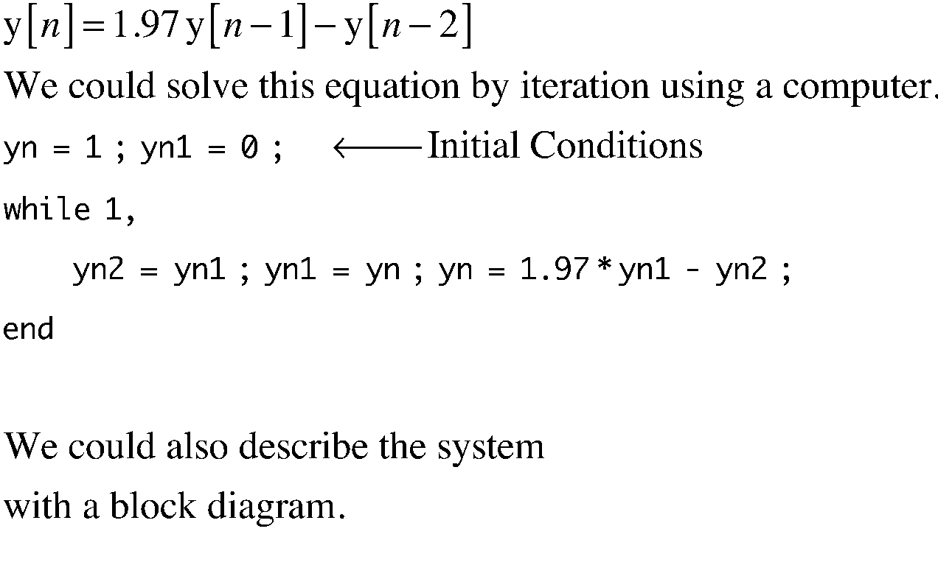
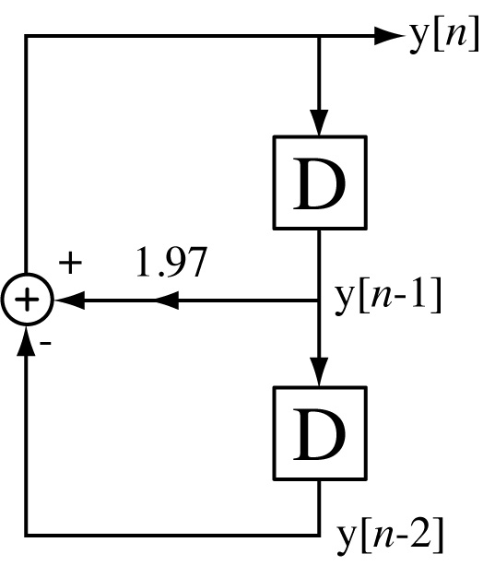
Discrete-Time Systems
M. J. Roberts - All Rights Reserved. Edited by Dr. Robert Akl
‹#›

Slide 33
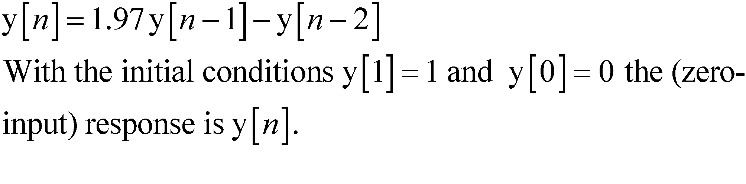
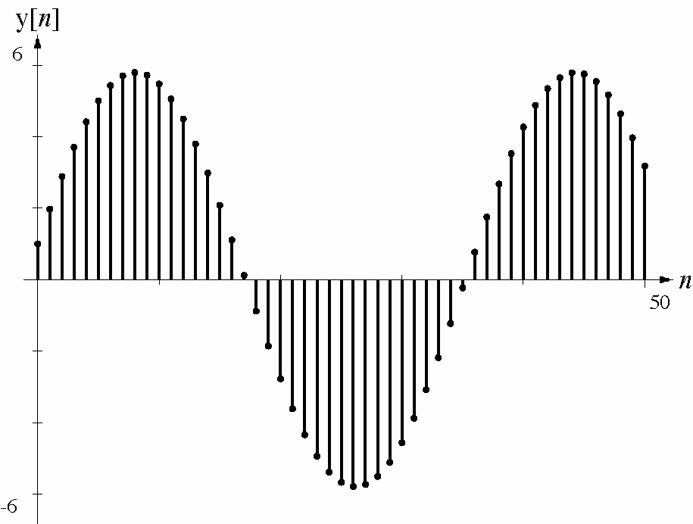
Discrete-Time Systems
M. J. Roberts - All Rights Reserved. Edited by Dr. Robert Akl
‹#›

Slide 34
System Properties
The properties of discrete-time systems have the same meaning as they do in continuous-time systems
M. J. Roberts - All Rights Reserved. Edited by Dr. Robert Akl
‹#›

Slide 35
Eigenfunctions of LTI Systems
The eigenfunction of an LTI system is the complex exponential
The eigenvalues are either real or, if complex, occur in complex conjugate pairs
Any LTI system excited by a complex sinusoid responds with another complex sinusoid of the same frequency, but generally a different amplitude and phase
All these statements are true of both continuous-time and discrete-time systems
M. J. Roberts - All Rights Reserved. Edited by Dr. Robert Akl
‹#›

